Slide 1
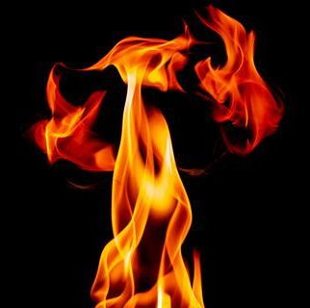
AUTOMATIC POSITIONING FIRE WATER CANNON
CHONG KHENG CHEN
03DET22F1043

Slide 2

KETERANGAN PROJEK
PENYATAAN MASALAH :
Do not put out the fire quickly when a fire breaks out
The fire cannot be discovered immediately
Unable to find fire extinguishing equipment quickly

Slide 3

OBJEKTIF PROJECT:
Can quickly put out the fire
Reduce casualties
Reduce casualties

Slide 4

SKOP KAJIAN :
SHOPPING MALL
HALL
FACTORY

Slide 5
KOS:
1.SENSOR FIRE –RM20
2.WATER PIPE-RM10
3.PUMP WATER- RM 30
4.ELECTRICAL PANEL-RM50
TOTAL-RM110

Slide 6
THANK YOU !!!

